Slide 1



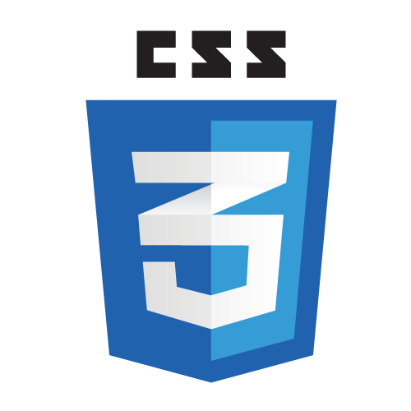
Frontend Class - 5

Slide 2
Angular

Slide 3
Angular
TypeScript
Angular is a JavaScript framework
which allows you to create reactive
Single Page Applications (SPAs)
Notes:
Angular is a platform that makes it easy to build applications with the web.
Angular combines declarative templates, dependency injection, end to end tooling, and integrated best practices to solve development challenges.

Slide 4
Angular - architecture
NgModule
Notes:
NgModule declares a compilation context for a set of components that is dedicated to an application domain, a workflow, or a closely related set of capabilities.
An NgModule can associate its components with related code, such as services, to form functional units.
Every Angular app has a root module, conventionally named AppModule, which provides the bootstrap mechanism that launches the application.
An app typically contains many functional modules.

Slide 5
Angular - architecture
NgModule
Notes:
NgModules can import functionality from other NgModules, and allow their own functionality to be exported and used by other NgModules.

Slide 6
Angular - architecture
NgModule
Notes:
Organizing your code into functional modules helps :
managing development of complex applications
designing for reusability
lazy-loading —loading modules on demand— in order to minimize the amount of code that needs to be loaded at startup.

Slide 7
Angular - architecture
NgModule
@Component
Notes:
Components define views, which are sets of screen elements that Angular can choose among and modify according to your program logic and data.
Components should focus on one main topic, ie:
Displaying a list
Displaying a detail screen
Card
Components are:
reusable
easy to update
limited in scope
Every Angular application has at least one component, the root component that connects a component hierarchy with the page DOM.
Each component defines a class that contains application data and logic, and is associated with an HTML template that defines a view to be displayed in a target environment.
The @Component decorator identifies the class immediately below it as a component, and provides the template and related component-specific metadata

Slide 8
Angular - architecture
NgModule
@Component
Notes:
Components define views, which are sets of screen elements that Angular can choose among and modify according to your program logic and data.
Every Angular application has at least one component, the root component that connects a component hierarchy with the page DOM.
Each component defines a class that contains application data and logic, and is associated with an HTML template that defines a view to be displayed in a target environment.
The @Component decorator identifies the class immediately below it as a component, and provides the template and related component-specific metadata

Slide 9

NgModule
Angular - architecture
@Component
< class >
< template >
Notes:
The class contains business logic
The template combines HTML with Angular markup that can modify the HTML elements before they are displayed.
Template directives provide program logic, and binding markup connects your application data and the document object model (DOM).

Slide 10
NgModule
Angular - architecture
@Component
property binding
< class >
< template >
Notes:
Data binding:
Property binding lets you interpolate values that are computed from your application data into the HTML.
Event binding lets your app respond to user input in the target environment by updating your application data.
Before a view is displayed, Angular evaluates the directives and resolves the binding syntax in the template to modify the HTML elements and the DOM, according to your program data and logic. Angular supports two-way data binding, meaning that changes in the DOM, such as user choices, can also be reflected back into your program data.
Your templates can also use pipes to improve the user experience by transforming values for display. Use pipes to display, for example, dates and currency values in a way appropriate to the user's locale. Angular provides predefined pipes for common transformations, and you can also define your own.

Slide 11
NgModule
Angular - architecture
@Component
property binding
< class >
< template >
event binding
Notes:
Data binding:
Property binding lets you interpolate values that are computed from your application data into the HTML.
Event binding lets your app respond to user input in the target environment by updating your application data.
Before a view is displayed, Angular evaluates the directives and resolves the binding syntax in the template to modify the HTML elements and the DOM, according to your program data and logic. Angular supports two-way data binding, meaning that changes in the DOM, such as user choices, can also be reflected back into your program data.
Your templates can also use pipes to improve the user experience by transforming values for display. Use pipes to display, for example, dates and currency values in a way appropriate to the user's locale. Angular provides predefined pipes for common transformations, and you can also define your own.

Slide 12
NgModule
Angular - architecture
@Component
< class >
< template >
Notes:
Data binding:
Property binding lets you interpolate values that are computed from your application data into the HTML.
Event binding lets your app respond to user input in the target environment by updating your application data.
Before a view is displayed, Angular evaluates the directives and resolves the binding syntax in the template to modify the HTML elements and the DOM, according to your program data and logic. Angular supports two-way data binding, meaning that changes in the DOM, such as user choices, can also be reflected back into your program data.
Your templates can also use pipes to improve the user experience by transforming values for display. Use pipes to display, for example, dates and currency values in a way appropriate to the user's locale. Angular provides predefined pipes for common transformations, and you can also define your own.

Slide 13

Angular - architecture
NgModule
@Component
< class >
< template >

Slide 14
Angular - architecture
NgModule
@Component
< class >
< template >
@Injectable
< service >
Notes:
For data or logic that is not associated with a specific view, and that you want to share across components, you create a service class.
A service class definition is immediately preceded by the @Injectable decorator. T
he decorator provides the metadata that allows your service to be injected into client components as a dependency.
Dependency injection lets you keep your component classes lean and efficient.
They don't fetch data from the server, validate user input, or log directly to the console; they delegate such tasks to services.

Slide 15
Angular - architecture
NgModule
@Component
directive
< class >
< template >
@Injectable
< service >
Notes:
Angular templates are dynamic. When Angular renders them, it transforms the DOM according to the instructions given by directives.
A directive is a class with a @Directive decorator.
A component is technically a directive - but components are so distinctive and central to Angular applications that Angular defines the @Component decorator, which extends the @Directive decorator with template-oriented features.
There are two kinds of directives:
- structural directives - change DOM
- attribute directives - only change the element they where it's placed on

Slide 16
Angular - architecture
NgModule
@Component
directive
< class >
< template >
pipe
@Injectable
< service >
Notes:
Pipes let you declare display-value transformations in your template HTML.
A class with the @Pipe decorator defines a function that transforms input values to output values for display in a view.
Angular defines various pipes, such as the date pipe and currency pipe; for a complete list, see the Pipes API list. You can also define new pipes.

Slide 17
Angular - architecture
NgModule
@Component
RouterModule
directive
< class >
< template >
pipe
@Injectable
< service >

Slide 18
Angular - architecture
NgModule
@Component
RouterModule
directive
< class >
< template >
HttpClientModule
pipe
@Injectable
< service >
Notes:
Most front-end applications communicate with backend services over the HTTP protocol.
Modern browsers support two different APIs for making HTTP requests: the XMLHttpRequest interface and the fetch() API.
The HttpClient in @angular/common/http offers a simplified client HTTP API for Angular applications that rests on the XMLHttpRequest interface exposed by browsers.
Additional benefits of HttpClient include testability features, typed request and response objects, request and response interception, Observableapis, and streamlined error handling

Slide 19
Angular - architecture
NgModule
@Component
RouterModule
directive
< class >
< template >
HttpClientModule
pipe
@Injectable
< service >

Slide 20
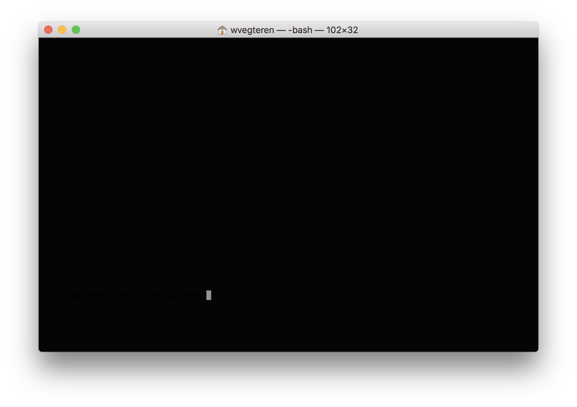
Angular - CLI
> npm install – g @angular/cli
Notes:
The Angular CLI makes it easy to create an application that already works, right out of the box.
It already follows the best practices defined by the Angular team

Slide 21
Angular - CLI
> ng new my-project
--routing
--skipTests
--inlineStyle
> cd my-project
> ng serve
Notes:
ng new – creates a new angular app
-
ng serve - starts server http://localhost:4200/ The app will automatically reload if you change any of the source files.

Slide 22
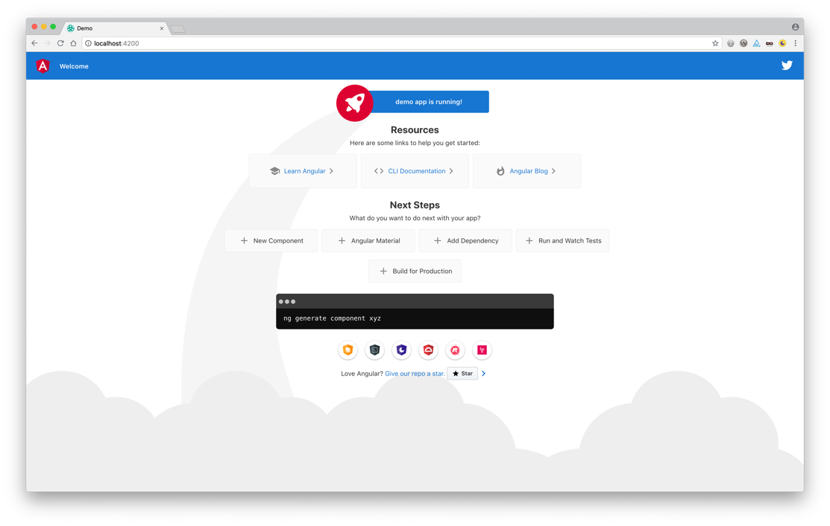
Angular

Slide 23

Angular
Notes:
explore project structure
bootstrap:
index.html -> main.js (compiled version of main.ts)
-> Bootstrap module AppModule
-> NgModule - bootstrap: [AppComponent]
In index.html component <app-root> is loaded. -> app.component.ts + app.component.html

Slide 24
Angular
Notes:
explore project structure
bootstrap:
index.html -> main.js (compiled version of main.ts)
-> Bootstrap module AppModule
-> NgModule - bootstrap: [AppComponent]
In index.html component <app-root> is loaded. -> app.component.ts + app.component.html

Slide 25
Angular - CLI
> ng new my-project
--routing
--skipTests
--inlineStyle
> cd my-project
> ng serve
> ng generate component MyFirstComponent
> ng g c MySecondComponent
> ng generate service MyService
> ng test
> ng e2e
> ng build
--prod
Notes:
ng generate – module, component, service, directive, pipe, etc
ng test – run unit tests with Karma
ng e2e – runs end 2 end tests with Protractor.
See for all options -> https://angular.io/cli

Slide 26
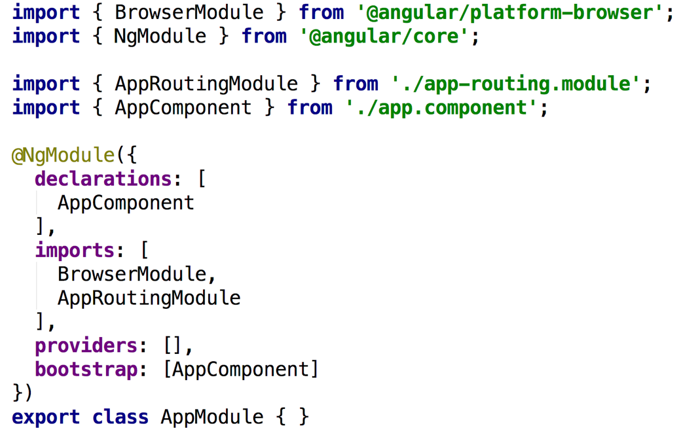
Angular - NgModule
Notes:
An NgModule is defined as a class decorated with @NgModule. The most important properties are:
declarations — The components, directives, and pipes that belong to this NgModule.
imports — Other modules whose exported classes are needed by component templates declared in this NgModule.
providers — Creators of services that this NgModule contributes to the global collection of services; they become accessible in all parts of the app. (You can also specify providers at the component level, which is often preferred.)
bootstrap—The main application view, called the root component, which hosts all other app views. Only the root NgModule should set this bootstrapproperty.

Slide 27
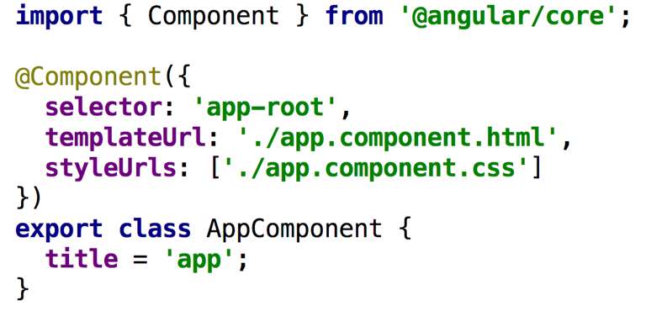
Angular - @Component
Notes:
The metadata for a component tells Angular where to get the major building blocks it needs to create and present the component and its view.
In particular, it associates a template with the component, either directly with inline code, or by reference. Together, the component and its template describe a view.
In addition to containing or pointing to the template, the @Component metadata configures, for example, how the component can be referenced in HTML and what services it requires.
selector needs to be unique
templateUrl vs template
styleUrls vs styles
provider
Components need to be registered within the declarations array of a module (ie. iapp.module.ts)

Slide 28
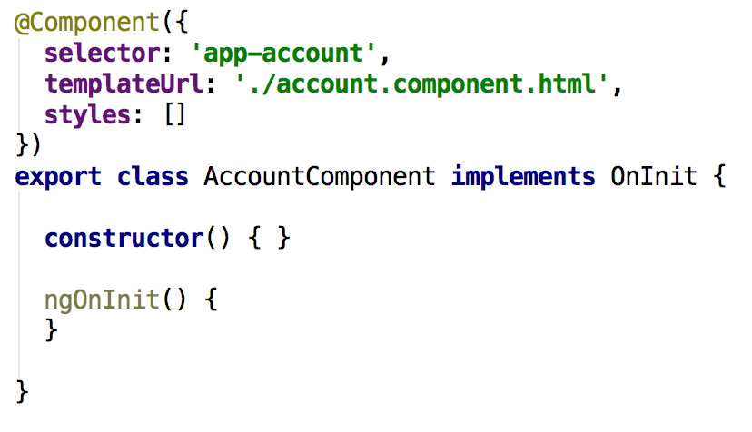
Angular - @Component
Notes:
When generating a component via CLI a ngOnInit function is added as well
ngOnInit is a lifecycle hook
Angular calls ngOnInit shortly after creating a component.
It's a good place to put initialization logic.
ngOnDestroy() is called Called just before Angular destroys the directive/component
Place to unsubscribe Observables and detach event handlers to avoid memory leaks.
See https://angular.io/guide/lifecycle-hooks for more information

Slide 29
Angular – data binding
Output data in html
string interpolation : {{ account.name }}
property binding: [disabled]="!allowNewAccount"
Notes:
= communication between TypeScript code (business logic) and Template (html)
String interpolation:
○ between curly braces everything is allowed that resolves to a string or can be converted to a string (like number)
○ static info als 'test', method calls, etc
○ multiline expressions are not possible
Property binding ie. [disabled]="!allowNewAccount"
○ data needs to resolve to the type required by the property ... in disabled case a Boolean
ie. [disabled]="!allowNewAccount"

Slide 30
Angular – data binding
React to user events
event binding : (click)="onCreate()"
(click)="onCreate($event)"
Notes:
event is named between the parentheses ie. (click)="onCreate()" method in TypeScript ... convention start with on ... ie. onCreate() reserved $event -> ie. onCreate($event) -> provide method with event data
onClick(event: Event) { this.title = (<HTMLInputElement>event.target).value; }

Slide 31
Angular – data binding
Combine property and event binding
Two way binding : [(ngModel)]="data"
ngModel directive requires the FormsModule from @angular/forms
Notes:
Two way binding, combination of output data and react to user events
banana in the box

Slide 32
Angular – directives
Structural directives
conditionally add or remove elements from DOM
* preceeds name of directive
<p *ngIf="accountCreated">Account created</p> <p *ngFor="let account of accounts"> … </p>
Non Structural directives
only change the element where directive is placed on
<p [ngStyle]="backgroundColor: getColor()"> … </p> <p [ngClass]="active: state == 'active'"> ... </p>
Notes:
Directives are instructions in the DOM
Non Structural - behind the colon an expression is expected

Slide 33
Angular – pipes
A pipe transforms input data to a desired output
{{ birthday | date }}
{{ birthday | date:'fullDate' | uppercase }}
{{ balance | currency:'EUR' }}
https://angular.io/guide/pipes
Notes:
Pipes can be chained

Slide 34
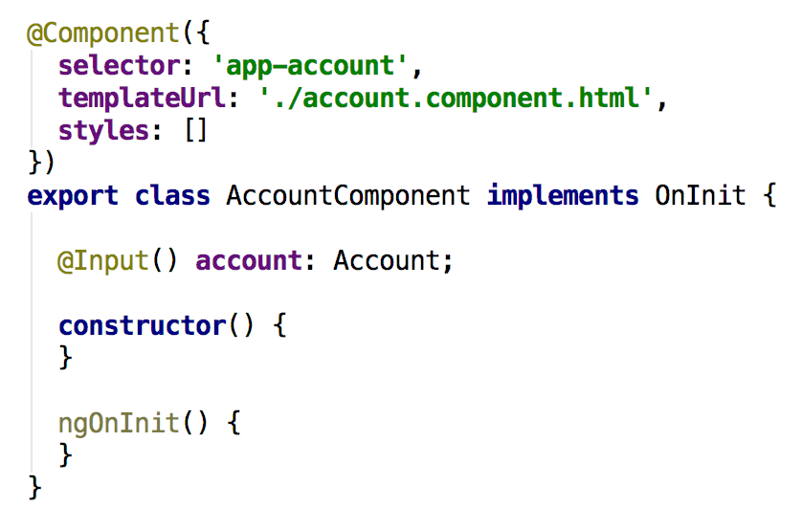
Angular – component interaction
Notes:
From Master to Detail -> ie. when selecting an account from a list …
- Use the @Input decorator to make the selected account available for binding
- Use property binding to pass the selected account to the account (details) component
You can define the @Input() decorator on variables … and functions (ie. setAccount()) as well
Detect and act upon changes to input property values with the ngOnChanges() lifecycle hook

Slide 35
Angular – component interaction
Root Component
Account List Component
@Output()
@Input()
Account Detail Component
Notes:
The child component exposes an EventEmitter property with which it emits events when something happens.
The parent binds to that event property and reacts to those events.
The child's EventEmitter property is an output property, typically adorned with an @Output decoration

Slide 36
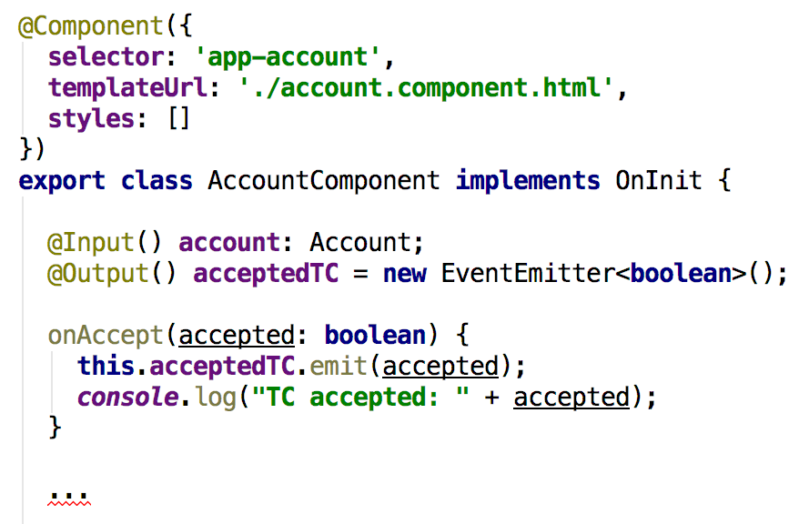
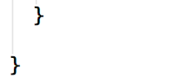
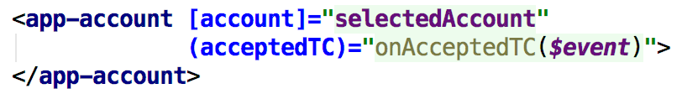
Angular – component interaction
Notes:
The child component exposes an EventEmitter property with which it emits events when something happens.
The parent binds to that event property and reacts to those events.
The child's EventEmitter property is an output property, typically adorned with an @Output decoration
Another way for component interaction is a shared Service

Slide 37
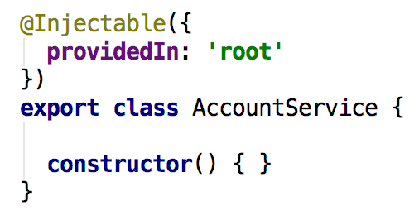
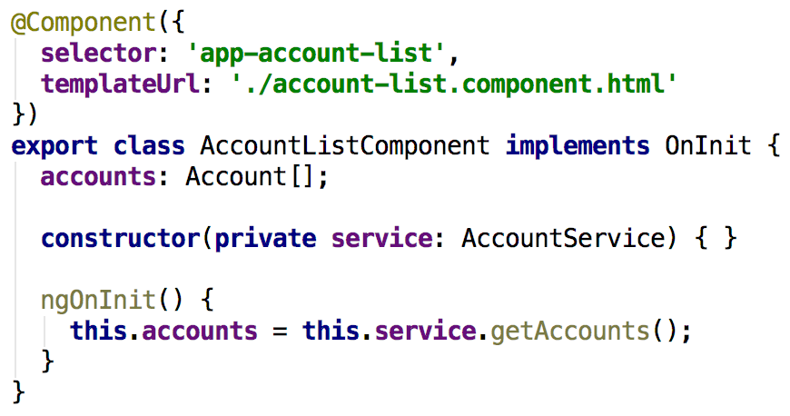
Angular – @Injectable
Notes:
ng generate service or ng g s
By default providedIn root -> global service, available for all components in the application
Injected via constructor – private varable !!!

Slide 38
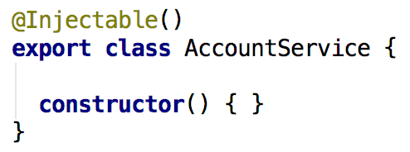
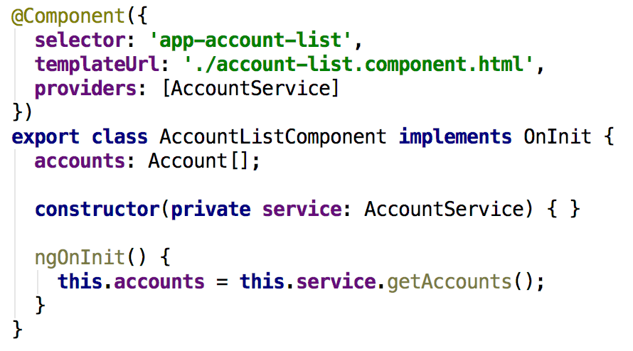
Angular – @Injectable
Notes:
providedIn root is optional.
When removed the Injectable needs to be added to the providers section of a module, component, etc.
In this case the AccountService is only available for the AccountListComponent

Slide 39
Angular – observables
Observables provide support for passing messages
between publishers and subscribers in your application.
Observables are not executed until a consumer subscribes to it.
The subscribed consumer then receives notifications
until the function completes, or until they unsubscribe.
Notes:
Part of RxJs
An observable can deliver multiple values of any type—literals, messages, or events, depending on the context.
The API for receiving values is the same whether the values are delivered synchronously or asynchronously.
Because setup and teardown logic are both handled by the observable, your application code only needs to worry about subscribing to consume values, and when done, unsubscribing. Whether the stream was keystrokes, an HTTP response, or an interval timer, the interface for listening to values and stopping listening is the same.
Because of these advantages, observables are used extensively within Angular

Slide 40
Angular – observables
Angular makes use of observables as an interface to handle
a variety of common asynchronous operations. For example:
The EventEmitter class extends Observable.
The HTTP module uses observables to handle AJAX requests and responses.
The Router and Forms modules use observables to listen for and respond to user-input events.
https://angular.io/guide/observables

Slide 41
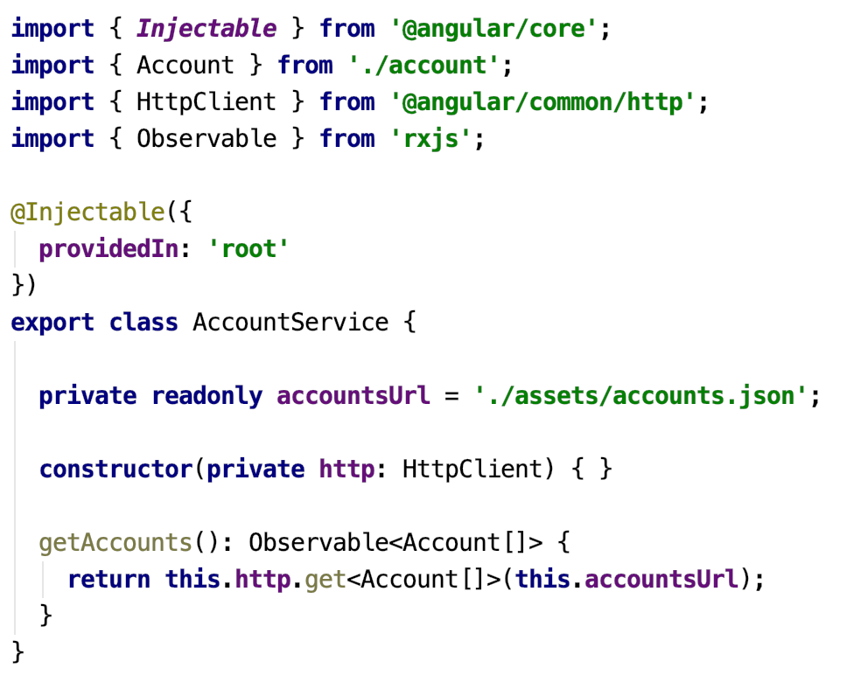
Angular – HttpClient

Slide 42
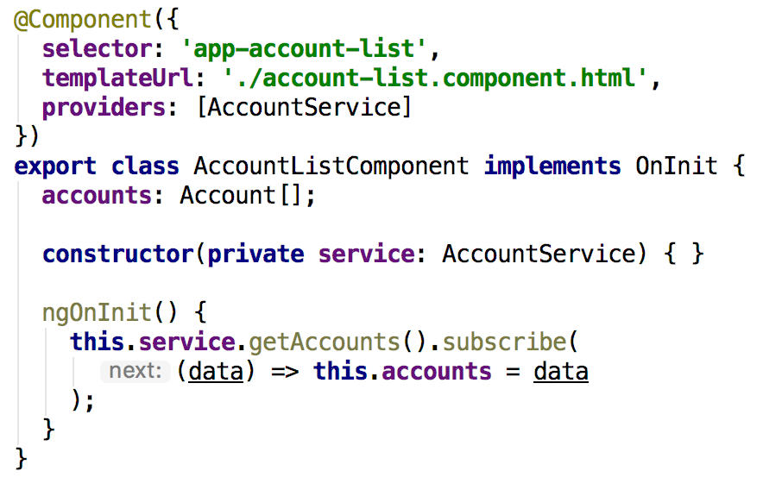
Angular – HttpClient
Notes:
You need to subscribe to an Observable

Slide 43
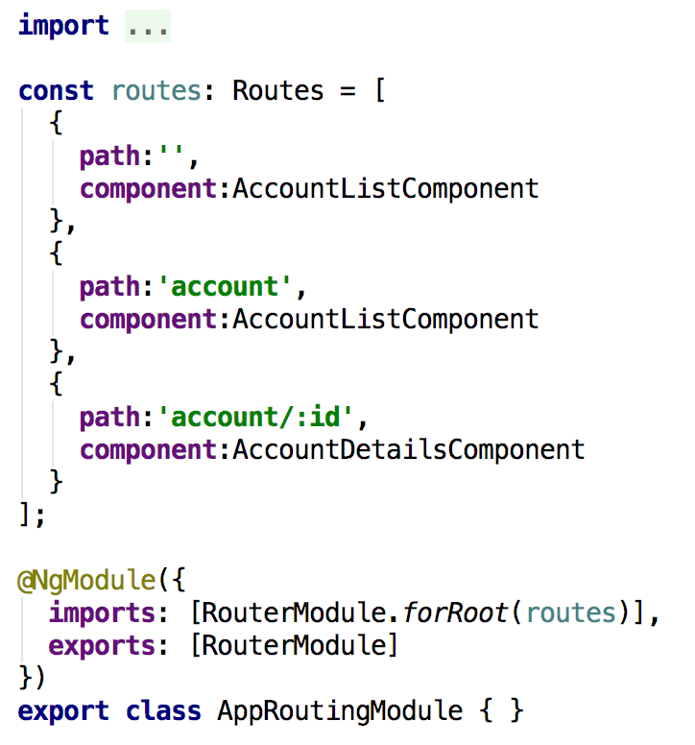
Angular – routing
Notes:
A routed Angular application has one singleton instance of the Router service.
When the browser's URL changes, that router looks for a corresponding Route from which it can determine the component to display.
app-routing.module.ts - generated by CLI ( --routing ) … with empty routes array.
Each route needs at least a path and a component. There are no leading slashes in the path.
** path is a wildcard -> page not found (404)
The order of the routes in the configuration matters and this is by design. The router uses a first-match wins strategy when matching routes,

Slide 44
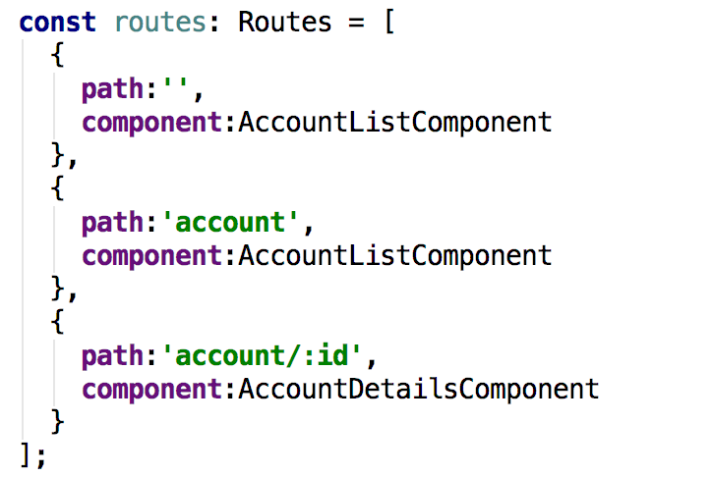
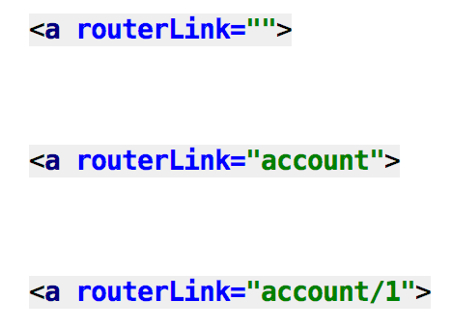
Angular – routing
<a routerLink="">
<a routerLink="posts">
<a routerLink="account/1234">
Notes:
Routes translated to links in HTML template
Use routerlink directive in stead of a href=“”. Href is releoading the page … execute a full bootstrap, etc.
Routerlink
routerlink:
/account – absolute path
account – relative path … wil be added to the current path
You need to define a <router-outlet> directive in your template to display the component that is activated by a route

Slide 45
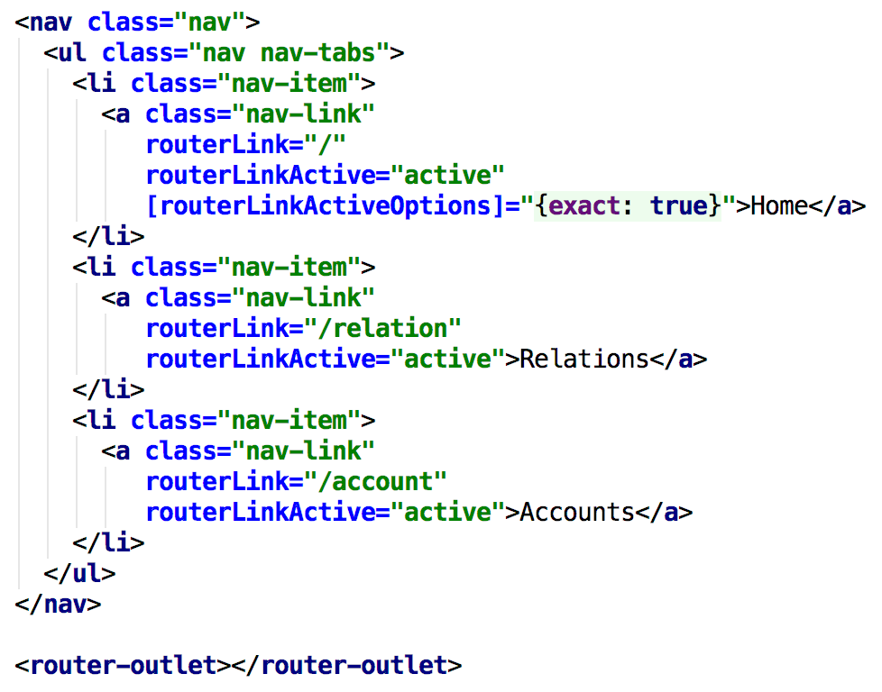
Angular – routing
Notes:
Routes translated to links in HTML template
Use routerLink directive in stead of a href=“”. Href is releoading the page … execute a full bootstrap, etc.
RouterLink
routerLink:
/account – absolute path
account – relative path … wil be added to the current path
You need to define a <router-outlet> directive in your template to display the component that is activated by a route

Slide 46
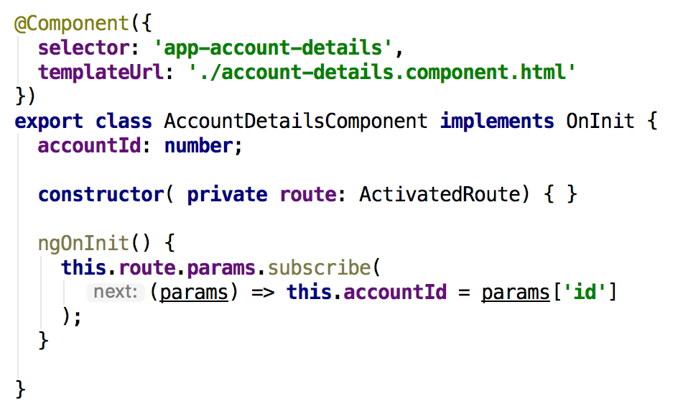
Angular – routing
Notes:
The route path and parameters are available through an injected router service called the ActivatedRoute.
Note: params.id maps to :id in route definition
Check Router,RoutingEvents

Slide 47
Angular – routing
Notes:
The route path and parameters are available through an injected router service called the ActivatedRoute.
Note: params.id maps to :id in route definition
Check Router,RoutingEvents

Slide 48
Angular – routing
Notes:
The route path and parameters are available through an injected router service called the ActivatedRoute.
Note: params.id maps to :id in route definition
Check Router,RoutingEvents

Slide 49
Angular – debugging
Chrome developer tools
console + debugger
Notes:
If something is not working as expected -> check console
At runtime only JavaScript is executed by the browser … error messages can be quite verbose and in example line numbers relate to the line numbers in the generated JavaScript code.
Developer tools – webpack -> access typescript code based on generated map-files

Slide 50
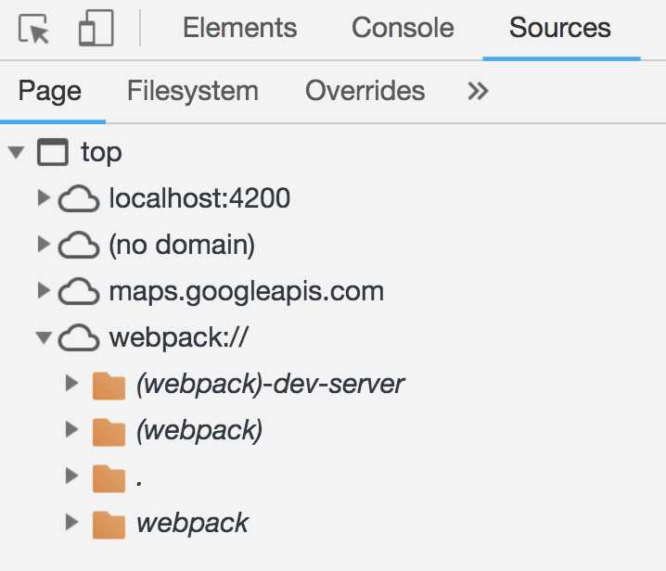
Angular – debugging
Chrome developer tools
console + debugger
Notes:
Developer tools – Sources
- via webpack:// . folder => access to TypeScript code and debug TypeScript code
access typescript code based on generated map-files, so DEV only

Slide 51
Angular – debugging
Chrome developer tools
console + debugger
Augury – extension for Chrome
https://augury.angular.io
Notes:
Augury helps to visualize the application through component trees, and visual debugging tools.
You get immediate insight into the application structure, change detection and performance characteristics.

Slide 52
Angular
https://angular.io

